Slide 1

VITA DOEV
VOLUNTEER INCOME TAX ASSISTANCE
Notes:
The IRS sponsors free tax preparation services in cities nationwide under the Volunteer Income Tax Assistance, VITA, program.

Slide 2

PREFACE
Notes:
This presentation takes the results of my project paper and begins the expansion of the data collection in the top five VITA states with a selected group of VITA site grantees. This is the coordination of efforts between higher education college and university, community organizations, and local financial institutions.

Slide 3
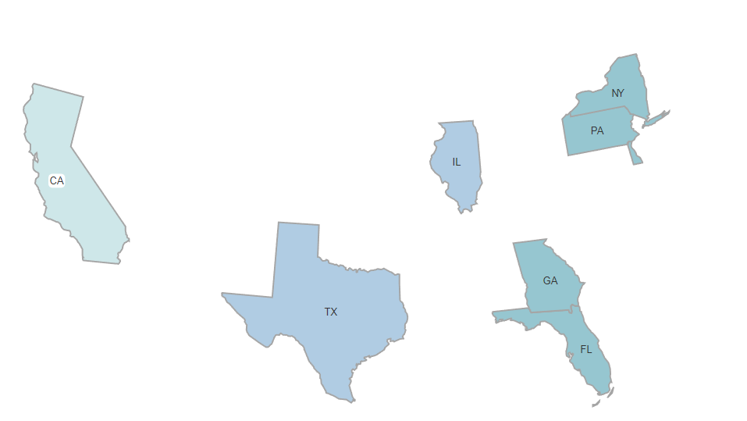

VITA SITE COORDINATORS
VITA States
Targeted Marketing
Expand Outreach
Improve Data Collection
Notes:
The recommendation from the 2020 IRS data analysis indicates California, Florida, Georgia, Illinois, New York, Pennsylvania and Texas are the most popular VITA states in several categories. Overall VITA prepared tax returns, the most Earned Income Tax Credit (EITC), refundable and non-refundable education credit, Dependent Child Care and other Child Tax Care Credits. These states will pilot our new data and expanded outreach program.

Slide 4
Four Step Completion
Develop
Organize
Engage
Verify
Notes:
VITA Sites will pilot our new approach to expand outreach, obtain better VITA metrics, and influence non-filers to file taxes. This will include tax education material to dispel misinformation and provide year-round tax resources.

Slide 5
Develop
Data Driven Metrics
Marketing Strategy and Plan
Educate
Notes:
Pilot program will focus on data driven design and metrics. Data Analysts students will review prior year site participants to identify Single Tax Filers, those with Earned Income Tax Credits (EITC), Child Care Credits, Educational Credits, prefer direct deposit, and computer-generated returns. Marketing students will create a marketing strategy, marketing campaign and assist with cobranded marketing campaigns with community organizations and financial institutions. These partnerships will create materials to educate taxpayers and dispel misinformation.

Slide 6
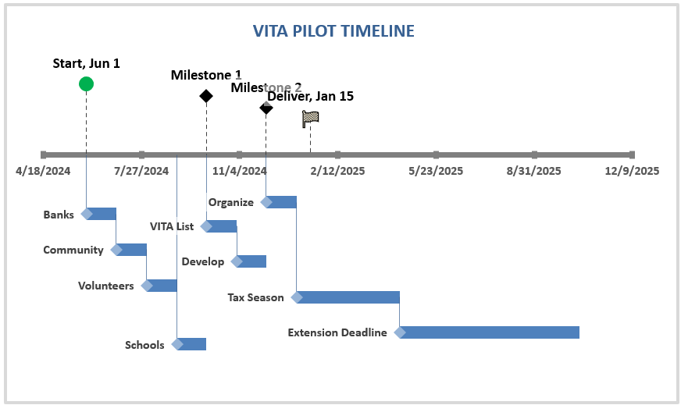
Organize
Notes:
The organize phase will timeline and coordinate work between all of resources, volunteers, financial institutions, organizations and VITA sites. This timeline will include training for VITA volunteers, creating marketing materials, and wait for tax irs publications for the Tax Season and the Tax extension deadline.

Slide 7

Engage
Marketing Campaigns
Community Outreach
Resources
Notes:
Marketing students will work create post completion surveys, marketing drip campaigns, text campaigns, social media ads and educational materials for onsite. They will take Data students data and begin marketing January, with increasing presence until Tax Deadline. They will also provide information regarding last day to file 2021 tax returns – trying to engage non-filers. Create banners, for VITA sites, and with sponsoring community organizations and financial institutions. Marketing students will work to engage community organization to pool efforts to increase outreach. Social work students will engage their community organization contacts and utilize the marketing materials to add more outreach opportunities.

Slide 8
Verify
Taxpayer Satisfaction
Volunteer Feedback
Site Coordinator Feedback
Sponsor Feedback
Notes:
Verification step will see if Pilot program met the target goals. Increase site participation with trackable aligned goals specific to each VITA site. Survey results from at least 75% of VITA participants – measuring – targeted marketing campaign, educational resources, direct deposit engagement, support/concerns of VITA program overall and VITA sites. Any issues with prior file taxes. Did a prior non-filer file after hearing about the program?

Slide 9
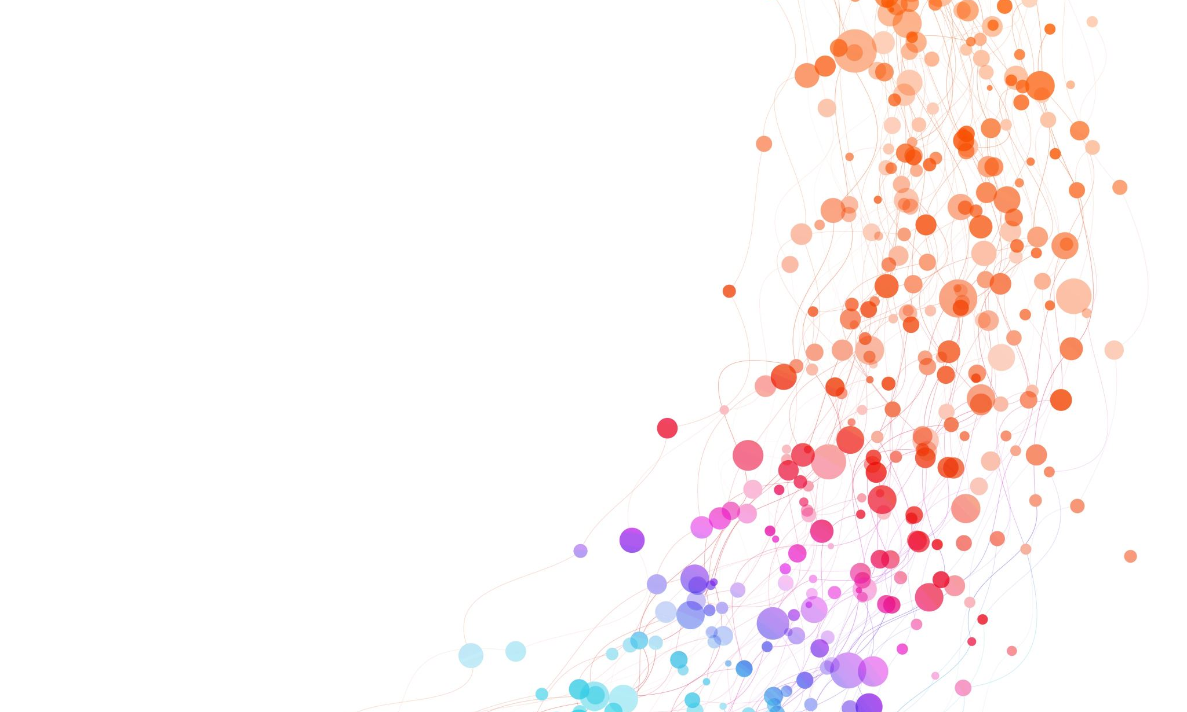
References
Notes:
References – include those from the preliminary research conducted which lead to the organization of this Pilot program. This provides all of the journal resources and initial data analysis performed by project sponsor.

Slide 10
References:
AARP. (n.d.). Free tax preparation from AARP Foundation Tax-aide. https://www.aarp.org/money/taxes/aarp_taxaide/?intcmp=AE-MON-TOENG-TOGL
The Associated Press. (2024, March 26). The IRS has 940,000 unclaimed tax refunds from 2020 that are about to expire. NPR. https://www.npr.org/2024/03/26/1240855533/irs-unclaimed-tax-refunds-2020
Bernhardt , B. C., & Wasser, J. M. (2024, March 4). IRS to Focus on High-Income Earners Who Have Not Filed Tax Returns. Fox Rothschild LLP - Attorneys at law. https://www.foxrothschild.com/publications/irs-to-focus-on-high-income-earners-who-have-not-filed-tax-returns
Blakemore, J. (2020, March 18). Five Benefits of VITA and VITA Volunteers. Get It Back. https://www.taxoutreach.org/blog/five-benefits-of-vita-and-vita-volunteers/#:~:text=Unlike%20paid%20preparers%2C%20who%20aren,rates%20higher%20than%2090%20percent.
Blanthorne, C., & Westin, S. (2016). Vita: A comprehensive review of the literature and an analysis of the program in Accounting Education in the U.S. Issues in Accounting Education, 31(1), 51–69. https://doi.org/10.2308/iace-51243
Boneh, S. (2018, January). SAS Programming Course Metropolitan State University of Denver. MTH 3510 - SAS Programming. Denver; Colorado. Retrieved March 31, 2024, from https://catalog.msudenver.edu/content.php?filter%5B27%5D=MTH&filter%5B29%5D=&filter%5Bcourse_type%5D=-1&filter%5Bkeyword%5D=&filter%5B32%5D=1&filter%5Bcpage%5D=1&cur_cat_oid=26&expand=&navoid=1614&search_database=Filter#acalog_template_course_filter.
Brown PC. (2024, January 10). Unfiled Tax Returns. Brown Tax, PC. https://www.browntax.com/irs-audits-and-appeals/irs-collection-matters/unfiled-tax-returns/
Davila, E. (2016a, September 18). Statistics foundations 1: The basics online class: Linkedin learning, formerly Lynda.com. LinkedIn. https://www.linkedin.com/learning/statistics-foundations-1/welcome?u=2245842
Davila, E. (2016b, September 18). Statistics foundations 3: Using data sets online class: Linkedin learning, formerly Lynda.com. LinkedIn. https://www.linkedin.com/learning/statistics-foundations-2/welcome?u=2245842
Davila, E. (2016c, September 18). Statistics foundations 4: Advanced Topics Online class: Linkedin learning, formerly Lynda.com. LinkedIn. https://www.linkedin.com/learning/statistics-foundations-3/welcome?u=2245842
Doyle, P. E., Matt, M. W., & Owens, B. T. (2005). A Student Perspective on the IRS s VITA Program. CPA Journal, 75(2), 44–47. https://eds-p-ebscohost-com.csuglobal.idm.oclc.org/eds/pdfviewer/pdfviewer?vid=11&sid=addde352-b374-4131-80b8-db41a1c1926f%40redis
Food Bank of New York City. (2024, April 3). File your taxes for free with Food Bank for New York City. Food Bank For New York City. https://www.foodbanknyc.org/taxhelp/
Frye, C. (2020, September 4). Tableau Essential Training Online Class: LinkedIn Learning, formerly Lynda.com. LinkedIn. https://www.linkedin.com/learning/tableau-essential-training-22386688
Goodwill. (2024, February 13). Free income tax preparation: Volunteer income tax assistance /tax counseling for elderly. Goodwill Industries of Central Michigan’s Heartland. https://www.goodwillcmh.org/program-services/free-income-tax-preparation/
GovInfo.gov. (1997, June 18). Volunteer protection act of 1997. govinfo.gov. https://www.govinfo.gov/content/pkg/PLAW-105publ19/pdf/PLAW-105publ19.pdf
IRS. (2023, October 16). IRS announces 2024 tax counseling for the elderly and volunteer income tax assistance program grants. Internal Revenue Service. https://www.irs.gov/newsroom/irs-announces-2024-tax-counseling-for-the-elderly-and-volunteer-income-tax-assistance-program-grants
IRS. (n.d.-a). Publication 1084 (rev. 10-2011) - IRS. https://www.irs.gov/pub/irs-utl/p1084.pdf
IRS. (n.d.-b). Soi tax stats - individual income tax statistics - 2019 ZIP code data (SOI). Internal Revenue Service. https://www.irs.gov/statistics/soi-tax-stats-individual-income-tax-statistics-2019-zip-code-data-soi
IRS. (n.d.-c). Soi tax stats - individual income tax statistics - 2021 ZIP code data (SOI). Internal Revenue Service. https://www.irs.gov/statistics/soi-tax-stats-individual-income-tax-statistics-2021-zip-code-data-soi-0
IRS.GOV. (2024, February 29). IRS launches new effort aimed at high-income non-filers; 125,000 cases focused on high earners, including millionaires, who failed to file tax returns with financial activity topping $100 billion. Internal Revenue Service. https://www.irs.gov/newsroom/irs-launches-new-effort-aimed-at-high-income-non-filers-125000-cases-focused-on-high-earners-including-millionaires-who-failed-to-file-tax-returns-with-financial-activity-topping-100-billion
IRS.GOV. (2024, March 25). Time running out to claim $1 billion in refunds for tax year 2020, Taxpayers Face May 17 deadline. Internal Revenue Service. https://www.irs.gov/newsroom/time-running-out-to-claim-1-billion-in-refunds-for-tax-year-2020-taxpayers-face-may-17-deadline
IRS.GOV. (n.d.-a). Chart A – for most people who must file. https://apps.irs.gov/app/vita/content/globalmedia/who_must_file_charts_a_b_4012.pdf
IRS.GOV. (n.d.-b). Interactive Tax Assistant. Support. https://itap1.for.irs.gov/owda/0/resource/Dependents_ITA/en-US/help/support.html
Kuglin, C., & Cardillo, A. (2021). The Role of Instructor Due Diligence in Volunteer Income Tax Assistance (VITA): Evidence From One University-Level Program. Journal of Accounting and Finance, 21(4), 156–166.
Notes:
References – include those from the preliminary research conducted which lead to the organization of this Pilot program. This provides all of the journal resources and initial data analysis performed by project sponsor.

Slide 11
References:
Lail, S., & Stowe, K. (2022). Analysis of a VITA Program’s Local Economic Impact. Business Education Innovation Journal, 14(2), 36–39.
Lim, Y., DeJohn, T. V., & Murray, D. (2012). Free tax assistance and the earned Income Tax Credit: Vital Resources for social workers and low-income families. Social Work, 57(2), 175–184. https://doi.org/10.1093/sw/sws035
Linos, E., Prohofsky, A., Ramesh, A., Rothstein, J., & Unrath, M. (2020). Can nudges increase take-up of the EITC?: Evidence from multiple field experiments. NATIONAL BUREAU OF ECONOMIC RESEARCH. https://doi.org/10.3386/w28086
Moura, B. (2024a, February 9). TAS assists victims of Vita Site Preparer Fraud. Taxpayer Advocate Service. https://www.taxpayeradvocate.irs.gov/news/success-stories/successstories-tas-assists-victims-of-vita-site-preparer-fraud/2017/05/
McCormick, K. (2017, July 10). Predictive analytics essential training: Data Mining Online Class: LinkedIn Learning, formerly Lynda.com. LinkedIn. https://www.linkedin.com/learning/the-essential-elements-of-predictive-analytics-and-data-mining/what-are-the-essential-elements?u=2245842
NCUA. (2021, November 3). Internal Revenue Service’s Volunteer Income Tax Assistance Program Collaboration Opportunities. https://ncua.gov/regulation-supervision/letters-credit-unions-other-guidance/internal-revenue-services-volunteer-income-tax-assistance-program-collaboration
Sherman, B. (2023, June 12). How to claim an undelivered tax refund. Congressman Brad Sherman. https://sherman.house.gov/taxrefund
SmartDraw. (n.d.-a). SmartDraw is the best way to make a diagram. https://app.smartdraw.com/editor.aspx?templateId=b7a134dd-c125-4c4e-88aa-1e45b7c074c5&noro=1&nsu=1&_gl=1%2Ale9pk9%2A_ga%2AMTUwOTA2MjI3Ni4xNzE1NDgxMjUx%2A_ga_9796Z3R0VG%2AMTcxNTQ4MTI1MC4xLjEuMTcxNTQ4MTM0Ni42MC4wLjA.%2A_gcl_au%2ANjI2MTI1NTU5LjE3MTU0ODEyNTE.#depoId=57315072&credID=-63834224
SmartDraw. (n.d.-b). USA Map. https://www.smartdraw.com/us-map/examples/usa-map/
Notes:
References – include those from the preliminary research conducted which lead to the organization of this Pilot program. This provides all of the journal resources and initial data analysis performed by project sponsor.

Slide 12
References:
Strupeck, C. D., & Whitten, D. (2004). Accounting service-learning experiences and the IRS volunteer income tax assistance programme: A teaching note. Accounting Education, 13(1), 101–112. https://doi.org/10.1080/0963928042000182475
Szendrey, J. (2021). Vita in a marketing research course: It’s not just for accounting students anymore. Journal of Education for Business, 97(6), 419–427. https://doi.org/10.1080/08832323.2021.1972918
Tripathi, A. (2022, April 17). Practice problems on hypothesis testing. Data Science Duniya. https://ashutoshtripathi.com/2022/04/17/practice-problems-on-hypothesis-testing/
United Way. (2024, April 11). Volunteer income tax assistance (VITA): Nonprofit charity donations. United Way of Tucson and Southern Arizona. https://unitedwaytucson.org/vita/
White, M. (2024, February 27). Metropolitan State University of Denver now offering free tax preparation services for Coloradans. CBS News. https://www.cbsnews.com/colorado/news/metropolitan-state-university-denver-free-tax-preparation-services-coloradans/
Z Table. (2021, April 7). Z test. Z TABLE. https://www.ztable.net/z-test/
Notes:
References – include those from the preliminary research conducted which lead to the organization of this Pilot program. This provides all of the journal resources and initial data analysis performed by project sponsor.

Slide 13
Appendix A – Pilot Teams
California
Florida
Azusa Pacific University
United Way of Fresno County
Orange County’s United Way
Koreatown Youth and Community Center
United Way of Merced
Community College Foundation
United Way of Volusia-Flagler Counties
United Way of Lee County
University of Florida
United Way of Northwest Florida
United way of Brevard
Notes:
Appendix A contains the college and universities, community organizations that will work with the VITA sites. These organizations will join our pilot program. Schools are listed in red to distinguish them from community organizations.

Slide 14
Appendix A – Pilot Teams
Georgia
Illinois
University of Georgia Research Foundation
United Way of Greater Atlanta
Goodwill Industries of Southern Ribers
United Way of Central Georgia
KTPS Business and Tax Clinic
Ladder Up
Mchenry County College
Community College District 502
Northwest Community Center
Notes:
Appendix A contains the college and universities, community organizations that will work with the VITA sites. These organizations will join our pilot program. Schools are listed in red to distinguish them from community organizations.

Slide 15
Appendix A – Pilot Teams
Pennsylvania
New York
United Way of Chester County
United Way of Lancaster County
Temple University of the Commonwealth System of Higher Education
Union-Synder Community Action Agency
United Way of Wyoming Valley
United Way of Buffalo & Erie County
Cornell University
Food Bank For New York City
Hartwick College
County of Westchester
Notes:
Appendix A contains the college and universities, community organizations that will work with the VITA sites. These organizations will join our pilot program. Schools are listed in red to distinguish them from community organizations.

Slide 16
Appendix A – Pilot Teams
Texas
United Way of Southern Cameron County
United Way of Metropolitan Dallas
University of Houston System
Texas A&M International University
Children’s Books on Wheels
Notes:
Appendix A contains the college and universities, community organizations that will work with the VITA sites. These organizations will join our pilot program. Schools are listed in red to distinguish them from community organizations.

